Slide 1
Machine Learning behind XR
Instructor: Lia Song
School of Computer and Mathematical Sciences
Faculty of Sciences, Engineering and Technology

Slide 2
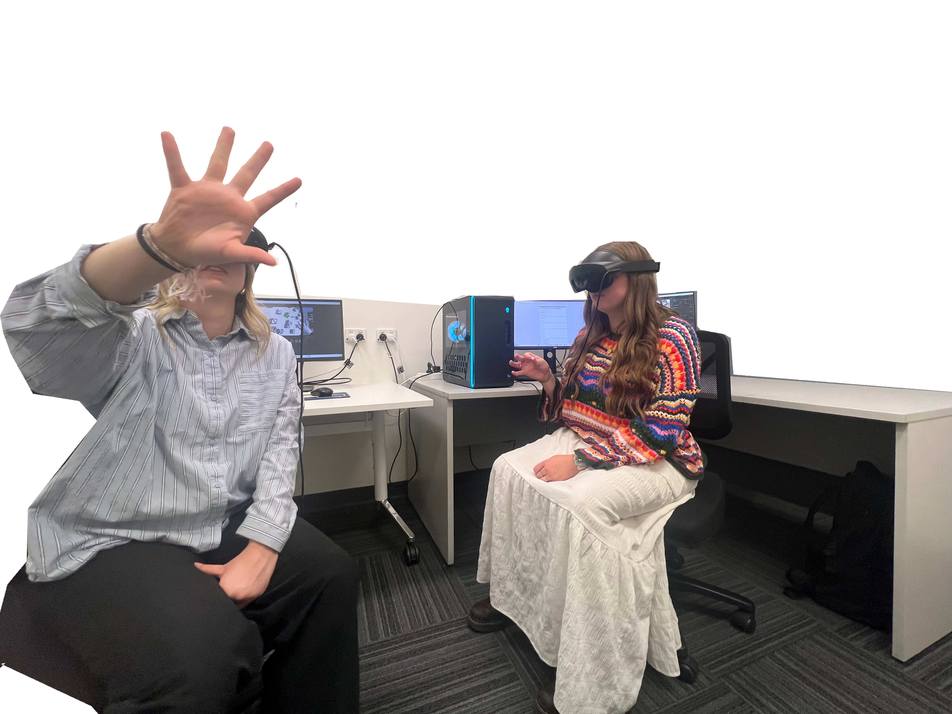
Enhancing Remote Collaboration in XR with Gaze & LLM/ML [Continued]
Explore Gaze Cues Combined with LLM/ML to Improve Communication in Virtual Reality Remote Collaboration
Yi Wang

Slide 3
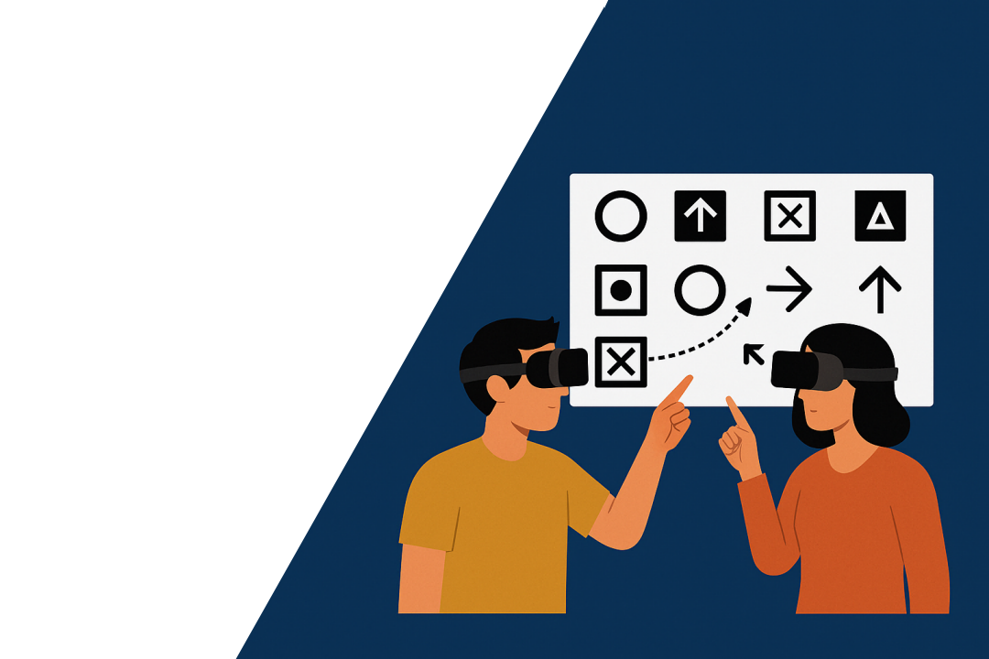
Introduction Of Work - What’s this project for?
Explore Gaze Cues Combined with LLM to Improve Communication in Virtual Reality Remote Collaboration
Introduction:
[Summary]
Gaze cues
to
VR collaboration
via
LLM or ML
· Explore the behavioral characteristics and feedback mechanisms of gaze cues in multi-user collaboration.
· Evaluate the effectiveness of machine learning–generated adaptive prompts under gaze-aware conditions;
Analyzing how ML models interpret gaze data to generate real-time supportive cues that enhance mutual understanding and reduce miscommunication during collaborative tasks.
· Develop a multimodal fusion system that integrates gaze tracking with machine learning models;
Enabling dynamic feedback and intelligent guidance based on users’ gaze behaviors. A collaborative VR prototype will be deployed for user evaluation, assessing usability, coordination efficiency, and user experience through both quantitative metrics and qualitative feedback.

Slide 4
Introduction of Work –
🧠 Model Design and Evaluation in VR Collaboration?
Custom MLP Model Design and Comparison with LLM
Comparison with Large Language Models (LLMs):
· We conducted a comparative evaluation between our custom MLP model and existing LLM-based solutions
(e.g., GPT-4 prompts combined with gaze context).
· While LLMs showed flexibility in language generation, they lacked the responsiveness and lightweight efficiency required for real-time gaze-based adaptation in VR.
Final Decision:
✅ Based on performance, latency, and system integration requirements, we selected our custom-designed MLP Machine Learning Model for deployment in the final prototype.
Input Layer
(Dimension: input_dim)
Fully ConnectedLayer 1
ReLU
+
Dropout
Fully ConnectedLayer 2
ReLU
+
Dropout
Output Layer
Gaze on/
Non gaze
Model Selection & Design
· In this project, we independently designed a lightweight customized Multi-Layer Perceptron (MLP) architecture tailored for real-time gaze classification in collaborative VR environments.
· The MLP model was trained to detect gaze interaction states (binary): ‘Gaze On’ and ‘Gaze Off’.

Slide 5
Introduction of Work –
🧠 Model Design and Evaluation in VR Collaboration?
Custom MLP Model Design and Comparison with LLM
Input Layer
(Dimension: input_dim)
Fully ConnectedLayer 1
ReLU
+
Dropout
Fully ConnectedLayer 2
ReLU
+
Dropout
Output Layer
Gaze on/
Non gaze
Input:
Speech
🧠 Model Design
Output:
Gazing or Not Gazing

Slide 6
Input:
Speech
🧠 Model Design
Output:
Gazing or Not Gazing
Which Model:
Large Language Model
or
Classic Machine Learning Model?

Slide 7
Model Design: Large Language Model
🧠 ML Model & System Design
🟦 Direct LLM-Based Gaze Classification (Initial Attempt)
🧪 Can a large language model (e.g., GPT-4) classify Gaze / Non-Gaze from raw user dialogue?
Input:
Speech
Prompt + GPT-4
Output:
Gazing or Not Gazing

Slide 8
Model Design: Large Language Model through “Prompt + GPT-4”
🧠 Prompting Strategy (Zero-shot Prompt Example) :
prompt = Here is a sentence from a VR collaboration conversation: \"{utterances}\”.
Classify whether this sentence is intended to direct attention (gaze) or not.
Answer only with "gaze" or "non gaze".
⚠️ Initial Findings:
❌ No fine-tuning → performance highly inconsistent
❌ Context-sensitive reasoning often misunderstood the VR task
❌ Latency per query ≈ 3 – 5 seconds (or more)
💰 Costly for real-time use (API-token based billing)

Slide 9
Model Design: Large Language Model through “Refined Prompt + GPT-4”
🟦 Refined Prompting: Better Accuracy, But Still Too Slow
🔄 What We Tried:
We modified our prompt to improve LLM’s understanding of task context by giving it reference cases:
✅ Result: Accuracy Improved
· Accuracy increased to ~around 75% (from ~65%)
· Fewer semantic misjudgments
· Better grounding in gaze-intent language
prompt = f"""
Here are two example utterances:
1. "It should be this cube, the one in front of you." → gaze
2. "I don't remember what color it was." → non gaze
Now classify the following:
\"{utterance}\"
Answer only with "gaze" or "non gaze".
"""
🐢 But It's Too Slow for Real-Time Use
Metric Refined Prompt
Average latency 5 – 7 seconds (or more) ⏳
VR usability ❌ Unacceptable for live interaction

Slide 10
Model Design: Local ML Model
🧠 ML Model & System Design
🟦 Local ML Model + Socket (our solution)
Input:
Speech
Local ML Model
Output:
Gazing or Not Gazing
🟩 Reframing the Problem:
From Prompting LLM to Supervised Learning

Slide 11
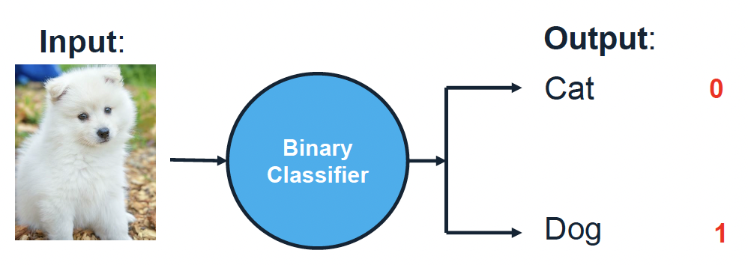
Model Design: Supervise Learning -- A Classification Example
ML Model
Input:
Speech
Gazing
Not Gazing
Problem: How to learn the ML model?
Input:
Speech
Local ML Model
Output:
Gazing or Not Gazing

Slide 12
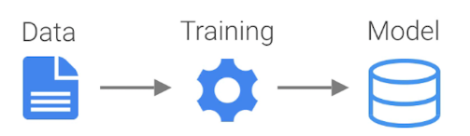
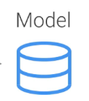

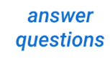
Supervise Learning: How to Learn a ML Model
Training and Testing learn models by training; and use learned models for testing
Training data: known input and output
Training:
Testing data: known input but unknown output
Testing:

Slide 13
Learn a ML Model: Practicing with Python in Jupyter Notebook

Slide 14
Supervise Learning: How to Learn a ML Model
Training and Testing learn models by training; and use learned models for testing
Training:
Testing:

Slide 15
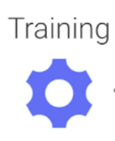



More details in Training use data to adjust an initial model approaching to a preferred model

Slide 16
Supervise Learning: How to Learn a ML Model
Stage I: Training
Step 1: Preparing the Data
Step 2: Training
Step 2.1 Decide a type of model (such as linear regression)
Step 2.2 Assign an initial parameters to the model
Step 2.3 Using data to update the parameters till optimal values
Step 3: saved the preferred model
Training:
Stage II: Testing
Step 1: load the saved model
Step 2: apply the model to calculate output of the new data with its input
Testing:

Slide 17
Use Python to Implement Machine Learning: Benefits
Simple, readable syntax
Great for beginners and fast prototyping
Rich ecosystem of libraries
e.g., scikit-learn, TensorFlow, PyTorch, pandas, NumPy, matplotlib
Strong community support
Abundant tutorials, forums, and documentation
Excellent tools for interactive development
Jupyter Notebook enables visual exploration and iterative coding
Cross-platform and open-source
Runs on Windows, macOS, Linux
Free and widely adopted in both academia and industry

Slide 18
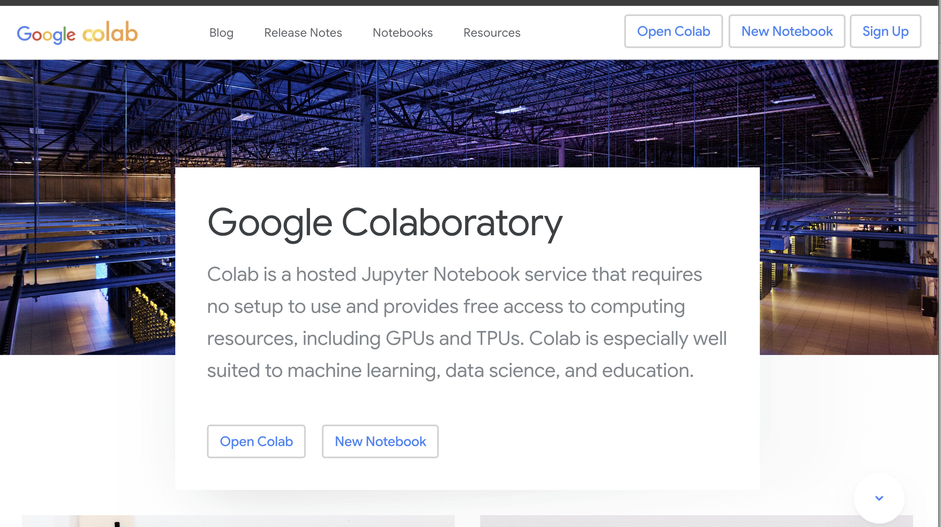
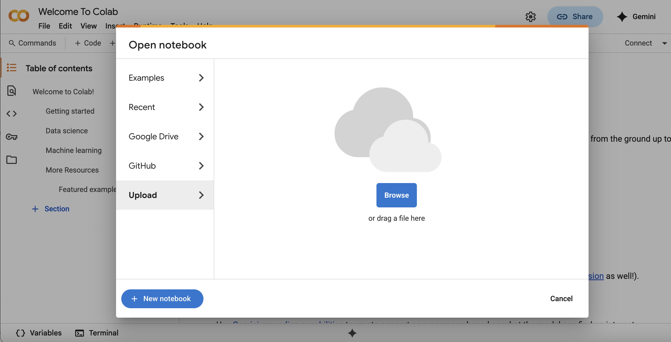
Try Python in Colab: https://colab.google/ ➔ Open Colab (login with Google Account) ➔ Upload Prac_Question.ipynb

Slide 19
Supervised Learning: How to obtain training data?

Slide 20
Model Design: Local ML Model
🧠 ML Model & System Design
🟦 Local ML Model + Socket (our solution)
Input:
Speech
Local ML Model
Output:
Gazing or Not Gazing
Socket: a pool of manually convert data which contains:
X: the vectorized speech
y: the label of gaze or off-gaze from “refined prompt + LLM”
🟩 Reframing the Problem:
From Prompting LLM to Supervised Learning

Slide 21
Q&A lia.song@adelaide.edu.au

